Slide 1
State Policy with MOPR Raab Roundtable April 28, 2020
Rob Gramlich
@RobGramlichDC
www.gridstrategiesllc.com
Notes:
Topics:
-what is causing low prices
-what are price effects of renewables in short term?
-long term
What structure works
What design works
First some facts and data

Slide 2
MOPR Moving Target
Grid Strategies estimate $5.7b/yr was about MOPR version 3.0
Recent IMM estimate was about version 9.0
New MOPR version in FERC rehearing order, v. 10.0, is different
Version 10.0 not yet defined
Bid levels up to FERC now
DR, EE, state procurement, utility self-supply implementation highly uncertain
Not up to PJM or the IMM
FERC on its own path
Goal is to raise prices (avoid “price suppression”)
Deciding regardless of cost, implementability, or effect on redundant capacity development

Slide 3
MOPR versions 1-9 No coherent consensus theory
PJM original for monopsony power mitigation
FERC/McIntyre—broad MOPR with resource-specific carve out
Re-pricing
MOPR-Ex
Calpine “clean”
Vistra
IMM & Lafleur proposals to exempt competitive REC procurements
IMM “Sustainable Market Rule”
PJM 2019 filing with Resource Carve Out
Also ISO-New England CASPR (v.1,2,3) and NYISO Buyer-Side Mitigation (v.1,2)

Slide 4
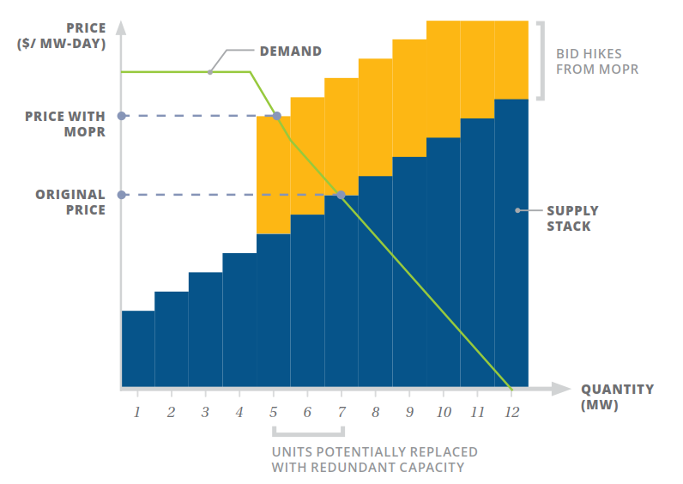
MOPR v. 10.0 Still Costly, Could Reduce Clean Energy, By Design
Demand response
Utility self-supply
Energy efficiency
State procurements (eg, NJ BGS)
Offshore wind equally impacted
Upcoming procurements to determine $ expected via capacity sales.
Soon if not next auction
Raises cost for load in ALL states
Adds capacity not chosen by states
Reduces clean energy if cost caps triggered

Slide 5
Resources Subject to New MOPR by 2030 33 GW unmet RPS demand by 2030, much more by new NJ by 2035 (7500MW Offshore Wind) and VA policies by 2040
Resource | MW nameplate | Capacity value | UCAP MW MOPRed
OVEC coal | 2300 | 0.91132 | 2096
Ohio nuclear units | 2150 | 0.98397 | Clears market
NJ nuclear units | 3631 | 0.98397 | Clears market
IL PJM nuclear units | 1880 | 0.98397 | Clears market
NJ Tier 1 RPS, wind | 1428 | 0.111 | 158
NJ Tier 1 RPS, solar | 1062 | 0.496 | 527
NJ solar carveout | 2465 | 0.496 | 1223
NJ offshore wind | 3500 | 0.26 | 910
Incremental Illinois RPS demand 2019-2030, wind | 533 | 0.111 | 59
Incremental Illinois RPS demand 2019-2030, solar | 1384 | 0.496 | 686
Other PJM state RPS demand, wind | 1877 | 0.111 | 208
Other PJM state RPS demand, solar | 5916 | 0.496 | 2934
MD wind | 1219 | 0.111 | 135
MD solar | 3212 | 0.496 | 1593
MD offshore | 1320 | 0.26 | 343
Accredited Capacity Sum: |  |  | 10,874 MW
+Self-supply
+DR
+EE
+State proc.

Slide 6
Does FRRexit Help States Achieve Goals?
Cost-reducing effect of FRR is known
Lower reserve margin required under FRR
IMM MD, IL FRR study assumptions are heroic
FRR that unnecessarily pays generators outside LDA more than what they would get in PJM auction
Price automatically assumed higher (net CONE*b) in half the scenarios
Assumes MOPR has no cost impact going forward, thus finds no savings
Only looks at next auction. State policies begin to take effect after that
Ignores flexibility provided in FRR for portfolio-based penalties
FRR is also undefined, there are good and bad FRR approaches

Slide 7
Achieving State Clean Energy Objectives with new MOPR
Hope MOPR reined in next year
Court review
FERC policy “aimed at” state policy
FERC policy change on whether mitigation is for a defined market failure, or anything that affects price.
Future FERC Commissioners
Proceed with plans
Prepare for the higher REC/ZEC/OREC costs in case MOPR sticks
Procure power, see if cost caps triggered
Consider FRRexit, design a procurement for the desired, energy, capacity, and environmental attributes
PJM process for a new approach

Slide 8
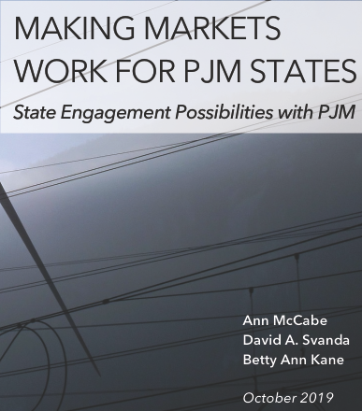
Alternative Approaches
Build up real wholesale buyers—state function
PJM focus on reliability services while states handle consumer price risk management
Lighter handed RTO/FERC resource adequacy
Australia style de-centralized procurement, with RTO review
ERCOT de-centralized market with active buyers
SPP, MISO, CAISO RTO approach
States collectively make Resource Adequacy policy calls
SPP Regional State Committee model
https://opsi.us/wp-content/uploads/2019/10/Making-Markets-Work-for-PJM-States-10-14-19-1.pdf

Slide 9
www.gridstrategiesllc.com
https://windsolaralliance.org

Slide 10
www.gridstrategiesllc.com
https://windsolaralliance.org

